Slide 1
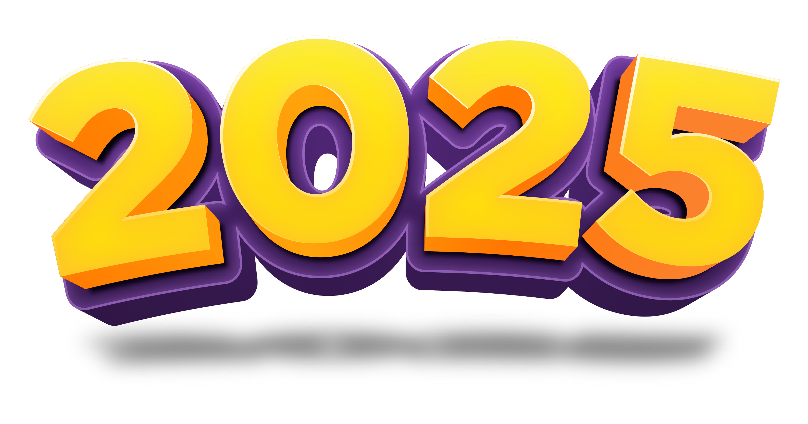
TENERIFE WINTER SESSIONS Aspire .NET+Functions+Dapr+ACA. El código Konami del desarrollo de tus aplicaciones en la nube

Slide 2



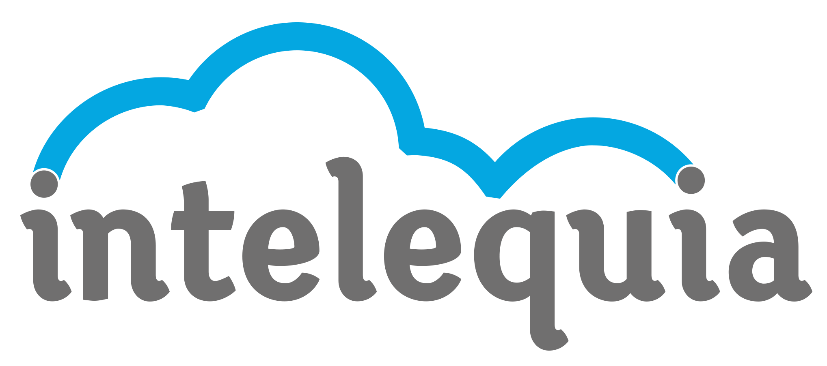



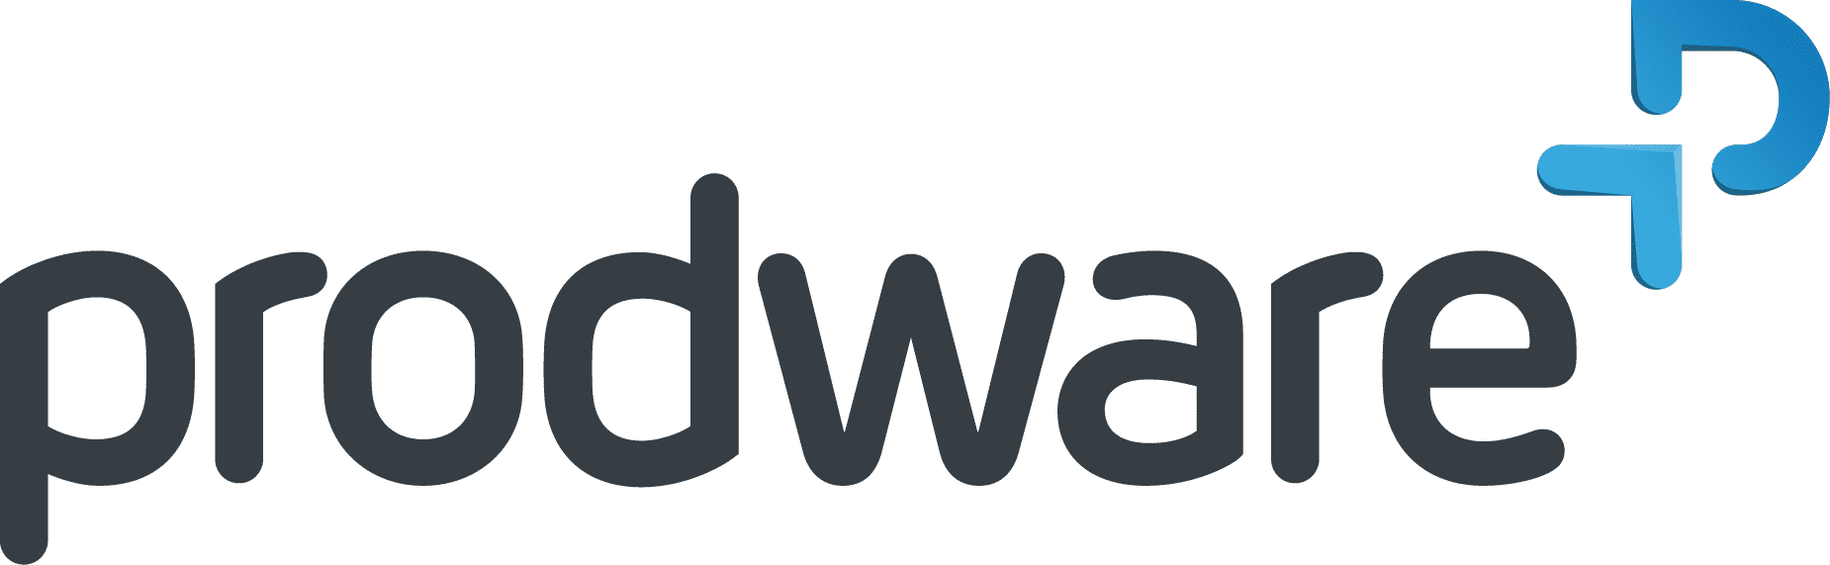
NUESTROS PATROCINADORES
Web3 Island
Makers
Sponsors
#Thanks

Slide 3





Hello!
Sergio Parra Guerra
“PARRITA”
@sparraguerra
@sparraguerra.bsky.social

Slide 4
Let’s play!
What’s Aspire .NET?
What’s Azure Functions?
What’s Dapr?
What’s Azure Container Apps?
Demo!

Slide 5
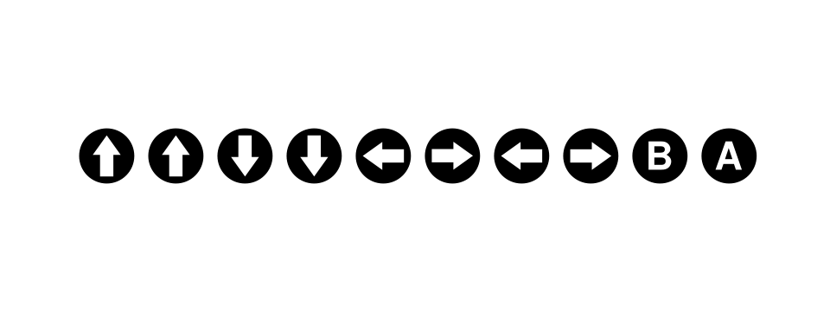
1. What’s Konami Code?
https://en.wikipedia.org/wiki/Konami_Code
Notes:
Es un truco que puede ser usado en ciertos videojuegos de Konami, que normalmente activa alguna opción secreta.

Slide 6
1. What’s Aspire .NET?

Slide 7
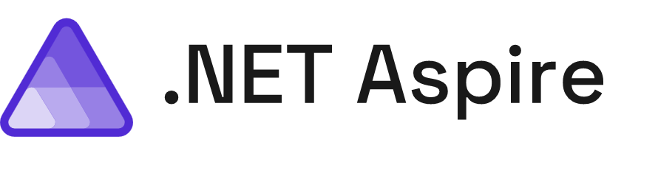
Powerful tools, templates, and packages for building observable, production ready, distributed applications
Notes:
¡Claro! .NET Aspire es una pila tecnológica diseñada para facilitar la creación de aplicaciones distribuidas y listas para producción en la nube. Aquí te dejo los puntos más importantes:
Orquestación de Aplicaciones: .NET Aspire simplifica la gestión de la configuración y las interconexiones de las aplicaciones en entornos de desarrollo locales¹. Esto incluye la gestión de variables de entorno y configuraciones de contenedores.
Integraciones: Ofrece paquetes NuGet para servicios populares como Redis y PostgreSQL, asegurando que se conecten de manera consistente y sin problemas con tu aplicación¹.
Plantillas y Herramientas: Proporciona plantillas de proyectos y herramientas para Visual Studio, Visual Studio Code y la CLI de .NET, facilitando la creación y gestión de proyectos .NET Aspire¹.
Panel de Control: Incluye un panel de control que permite monitorear y gestionar las aplicaciones de manera centralizada².
Observabilidad y Resiliencia: Integra herramientas para la observabilidad y la resiliencia de las aplicaciones, como OpenTelemetry para el monitoreo y la telemetría¹.
Despliegue: Facilita el despliegue en entornos de producción, incluyendo la integración con Azure y otros servicios en la nube¹.
Estos componentes hacen de .NET Aspire una opción robusta para desarrollar aplicaciones modernas y escalables. ¿Hay algún aspecto específico que te gustaría explorar más a fondo?

Slide 8
Problems to solve
Complex
Getting Started
Choices
Paved Path
Notes:
¡Claro! .NET Aspire es una pila tecnológica diseñada para facilitar la creación de aplicaciones distribuidas y listas para producción en la nube. Aquí te dejo los puntos más importantes:
Orquestación de Aplicaciones: .NET Aspire simplifica la gestión de la configuración y las interconexiones de las aplicaciones en entornos de desarrollo locales¹. Esto incluye la gestión de variables de entorno y configuraciones de contenedores.
Integraciones: Ofrece paquetes NuGet para servicios populares como Redis y PostgreSQL, asegurando que se conecten de manera consistente y sin problemas con tu aplicación¹.
Plantillas y Herramientas: Proporciona plantillas de proyectos y herramientas para Visual Studio, Visual Studio Code y la CLI de .NET, facilitando la creación y gestión de proyectos .NET Aspire¹.
Panel de Control: Incluye un panel de control que permite monitorear y gestionar las aplicaciones de manera centralizada².
Observabilidad y Resiliencia: Integra herramientas para la observabilidad y la resiliencia de las aplicaciones, como OpenTelemetry para el monitoreo y la telemetría¹.
Despliegue: Facilita el despliegue en entornos de producción, incluyendo la integración con Azure y otros servicios en la nube¹.
Estos componentes hacen de .NET Aspire una opción robusta para desarrollar aplicaciones modernas y escalables. ¿Hay algún aspecto específico que te gustaría explorar más a fondo?

Slide 9
2. What’s Azure Functions?

Slide 10

Azure Functions
An event-driven, serverless compute service that accelerates app development
Integrated programming model
Supported various triggers and bindings to define when a function is invoked and to what data sources it connects
End-to-end development experience
Local end-to-end development experience with Functions from building and debugging locally on major platforms like Windows, macOS, and Linux to deploying and monitoring in the cloud
Hosting options flexibility
Choose the host environments that better fits your business needs without compromising development experience
Fully managed and cost-effective
Automated and flexible scaling based on your workload volume, keeping the focus on adding value instead of managing infrastructure
Notes:
Azure Functions is a serverless solution that allows you to write less code, maintain less infrastructure, and save on costs. Instead of worrying about deploying and maintaining servers, the cloud infrastructure provides all the up-to-date resources needed to keep your applications running.
You focus on the code that matters most to you, in the most productive language for you, and Azure Functions handles the rest.
For the best experience with the Functions documentation, choose your preferred development language from the list of native Functions languages at the top of the article.
Scenarios
Functions provides a comprehensive set of event-driven triggers and bindings that connect your functions to other services without having to write extra code.
The following are a common, but by no means exhaustive, set of integrated scenarios that feature Functions.
Process file uploads Run code when a file is uploaded or changed in blob storage.
Process data in real time Capture and transform data from event and IoT source streams on the way to storage.
Infer on data models Pull text from a queue and present it to various AI services for analysis and classification.
Run scheduled task Execute data clean-up code on pre-defined timed intervals.
Build a scalable web API Implement a set of REST endpoints for your web applications using HTTP triggers.
Build a serverless workflow Create an event-driven workflow from a series of functions using Durable Functions.
Respond to database changes Run custom logic when a document is created or updated in Azure Cosmos DB.
Create reliable message systems Process message queues using Queue Storage, Service Bus, or Event Hubs.
These scenarios allow you to build event-driven systems using modern architectural patterns. For more information, see Azure Functions Scenarios.
Development lifecycle
With Functions, you write your function code in your preferred language using your favorite development tools and then deploy your code to the Azure cloud. Functions provides native support for developing in C#, Java, JavaScript, PowerShell, Python, plus the ability to use more languages, such as Rust and Go.
Functions integrates directly with Visual Studio, Visual Studio Code, Maven, and other popular development tools to enable seamless debugging and deployments.
Functions also integrates with Azure Monitor and Azure Application Insights to provide comprehensive runtime telemetry and analysis of your functions in the cloud.
Hosting options
Functions provides a variety of hosting options for your business needs and application workload. Event-driven scaling hosting options range from fully serverless, where you only pay for execution time (Consumption plan), to always warm instances kept ready for fastest response times (Premium plan).
When you have excess App Service hosting resources, you can host your functions in an existing App Service plan. This kind of Dedicated hosting plan is also a good choice when you need predictable scaling behaviors and costs from your functions.
If you want complete control over your functions runtime environment and dependencies, you can even deploy your functions in containers that you can fully customize. Your custom containers can be hosted by Functions, deployed as part of a microservices architecture in Azure Container Apps, or even self-hosted in Kubernetes.

Slide 11
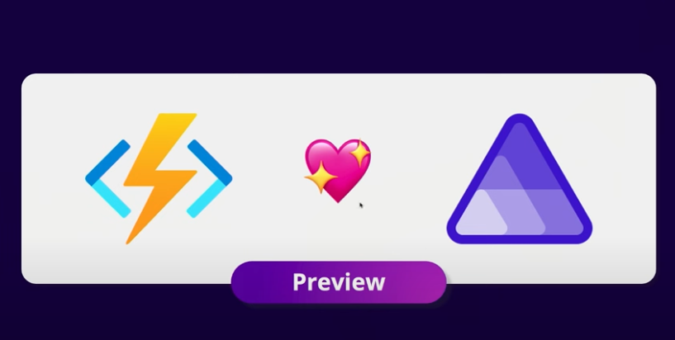

Slide 12
3. What’s Dapr?

Slide 13
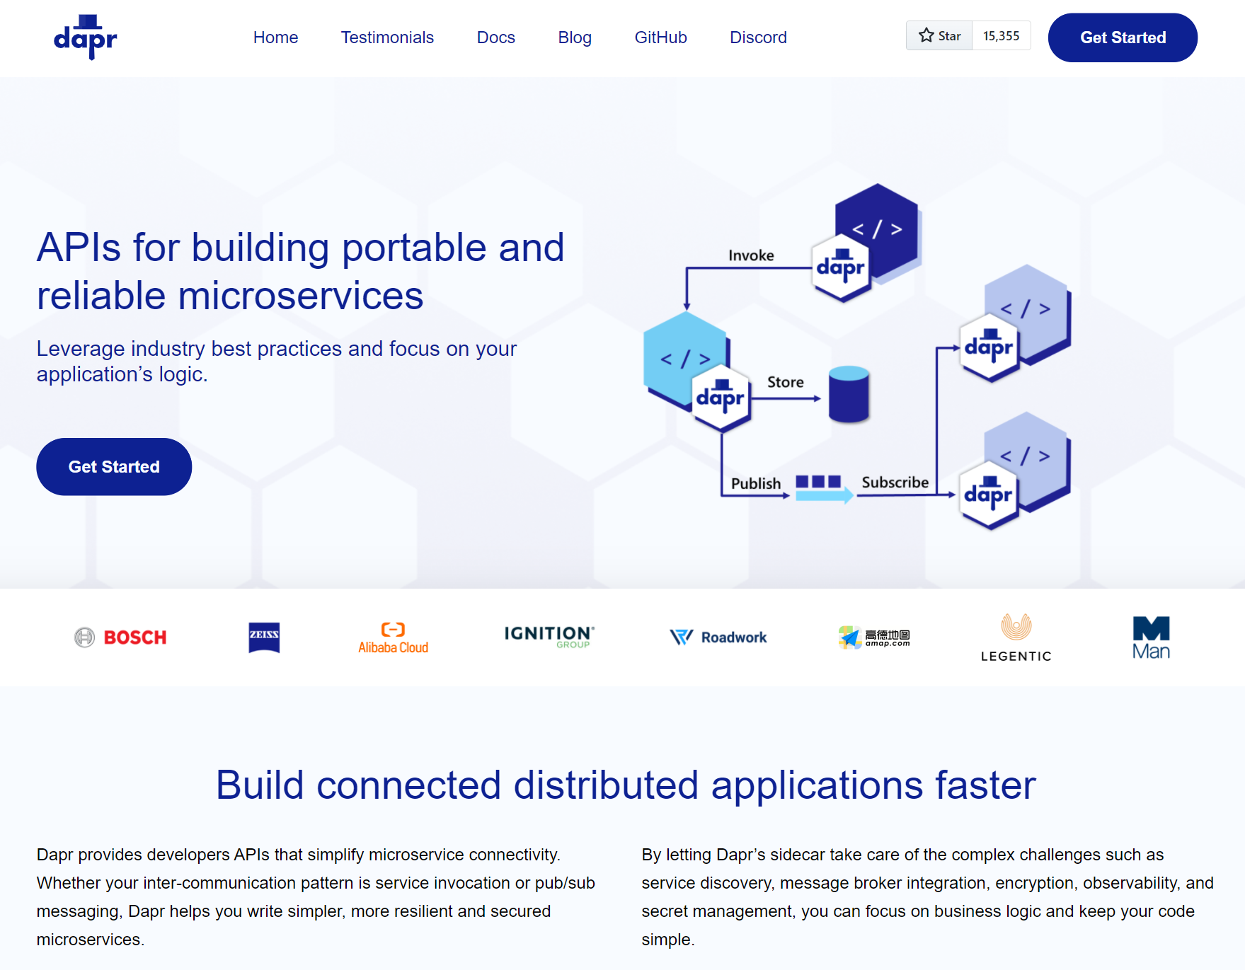

Distributed Application Runtime
dapr.io
Notes:
Dapr: Distributed Application Runtime
Es un conjunto de APIs que permiten a los desarrolladores implementar aplicaciones de microservicios portables y confiables.
Podemos trabajar con
State Management.
Secretos.
Patrón pub/sub.
Etc…
El objetivo de Dapr es proporcionar fiabilidad, resiliencia a través de reintentos, marcha atrás, circuit breaker. Las comunicaciones están son seguras, ya que se encuentran encriptadas mTLS. Al final tenemos una aplicación realmente portable

Slide 14
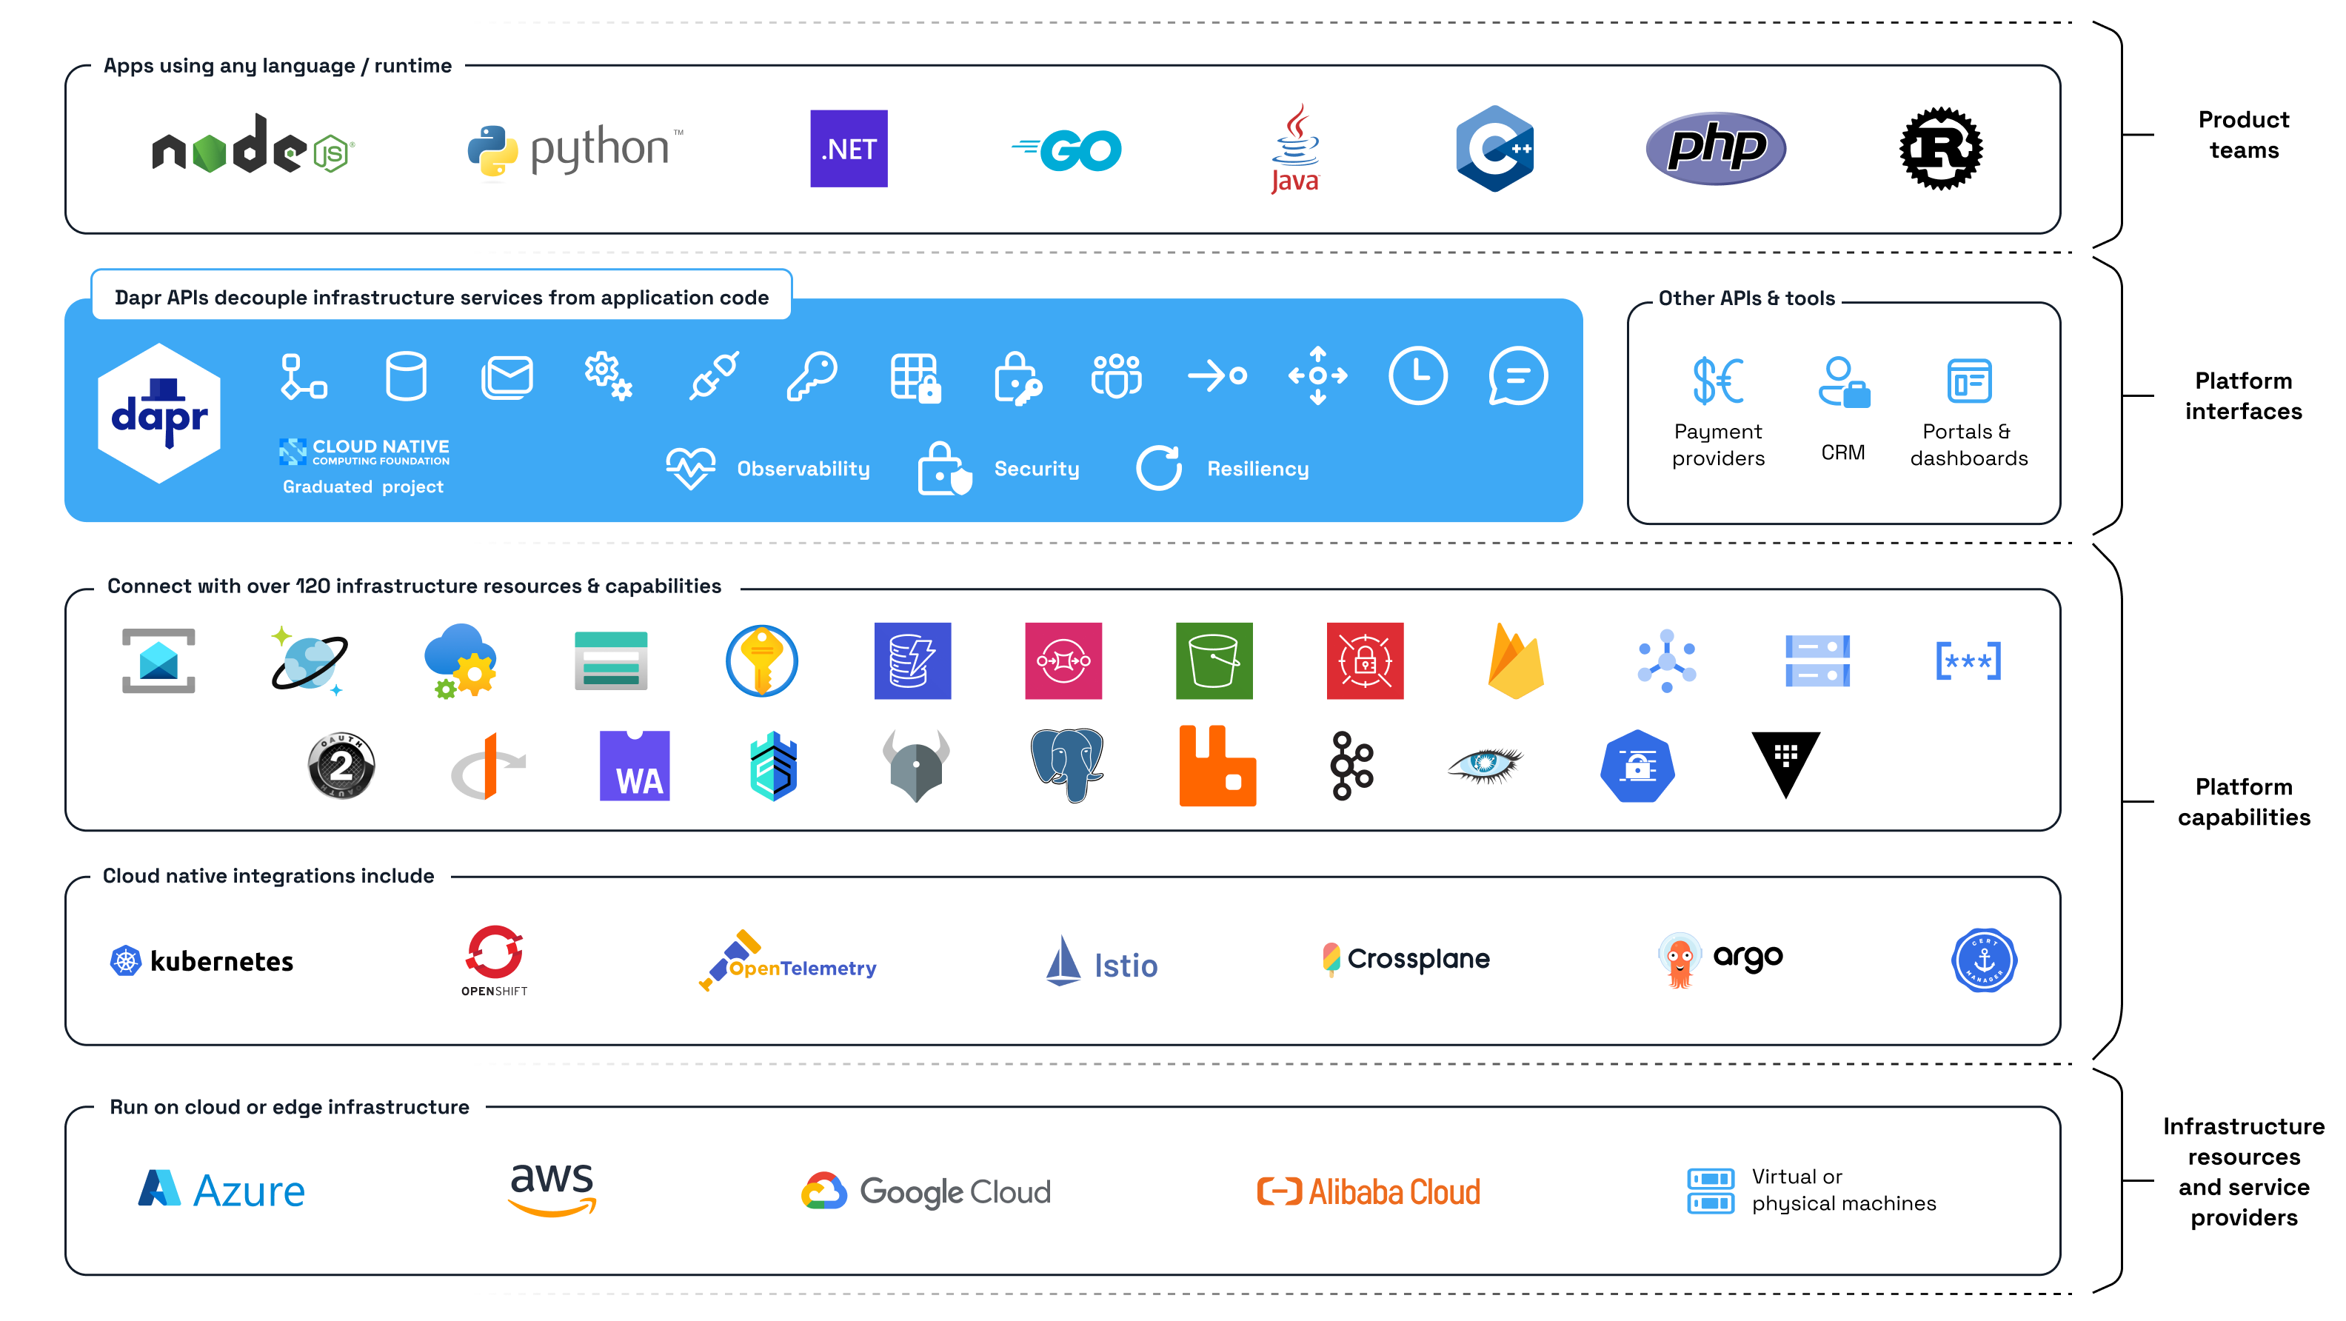
Solving Platform Engineering Challenges
Notes:
Infrastructure complexity & coupling
The Dapr building block APIs, provide an abstraction over the underlying infrastructure. Development teams don’t require product-specific SDKs when using the Dapr APIs, making it easy to switch from one product to another and support multiple different products of the same type. For example; developers use the Dapr Pub/Sub API in their code, and during development, they use Redis Streams as the message broker that runs locally in a container, while the production environment uses Kafka that runs in the cloud. Equally, platform teams can provide multiple messaging products such as Kafka, Pulsar, and RabbitMQ, and development teams can use either of them using the same Pub/Sub API.
Observability to resolve production issues
Dapr improves observability in distributed applications since all communication between applications and infrastructure passes through the Dapr process. Dapr natively integrates with OpenTelemetry, and by automatically generating and propagating tracing contexts using the W3C tracing specification across all its APIs, Dapr removes the need for manual instrumentation, saving development time. This allows for easier telemetry data collection that includes metrics, logs, and traces and faster time to resolution of issues, given the critical need for observability in production environments.
Managing security & compliance
Dapr has several built-in features to manage secure communication, access control and authentication. Dapr uses mutual Transport Layer Security (mTLS) to encrypt communication between services, ensuring data integrity and confidentiality. Access Policies can be defined by the platform team to control access to services, infrastructure resources (components) and secrets for governance. Additionally, Dapr supports middleware components, such as OAuth 2.0, which can handle authentication and authorization for web APIs.
High reliability and resiliency
Dapr improves application resiliency by providing platform engineers with configurable policies for retries, circuit breakers, and timeouts. These policies can be scoped to specific applications, infrastructure resources (components), enabling fine-grained control and improved application uptime.
Platform integration capabilities
Dapr provides Kubernetes-native custom resource definitions to configure applications and infrastructure resources (components), enabling platform engineers to leverage GitOps and tools like ArgoCD. Dapr integrates with policy engines like Kyverno and OPA, simplifying the tasks related to compliance and governance, protecting product teams from misconfigurations.

Slide 15
4. What’s Azure Container Apps?

Slide 16
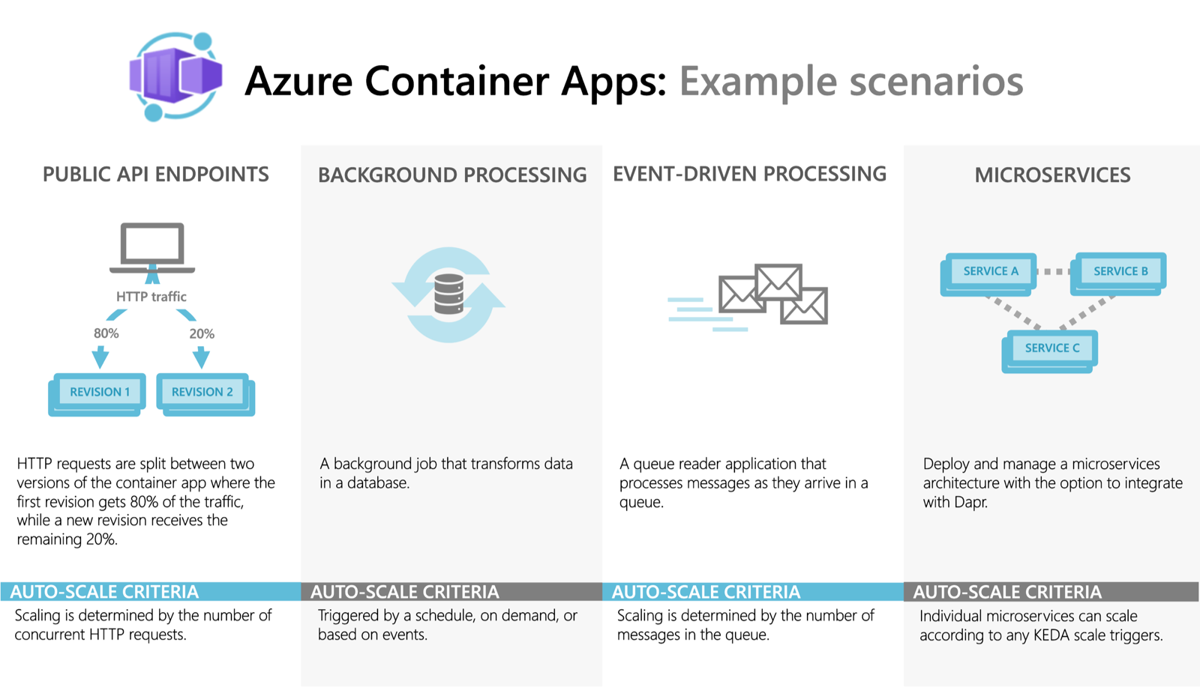
Solving Platform Engineering Challenges
Notes:
Azure Container Apps is a serverless platform that allows you to maintain less infrastructure and save costs while running containerized applications. Instead of worrying about server configuration, container orchestration, and deployment details, Container Apps provides all the up-to-date server resources required to keep your applications stable and secure.
Common uses of Azure Container Apps include:
Deploying API endpoints
Hosting background processing jobs
Handling event-driven processing
Running microservices
Additionally, applications built on Azure Container Apps can dynamically scale based on the following characteristics:
HTTP traffic
Event-driven processing
CPU or memory load
Any KEDA-supported scaler

Slide 17
DEMO!

Slide 18
4. Extra. What’s AZD?

Slide 19
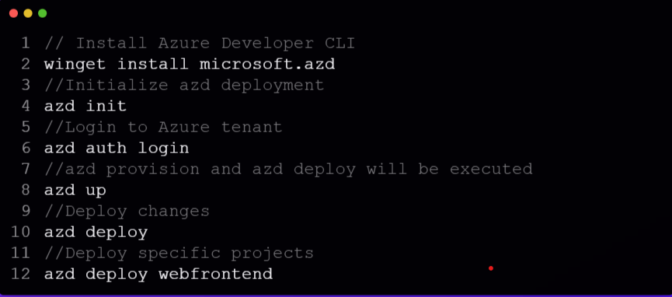

Slide 20
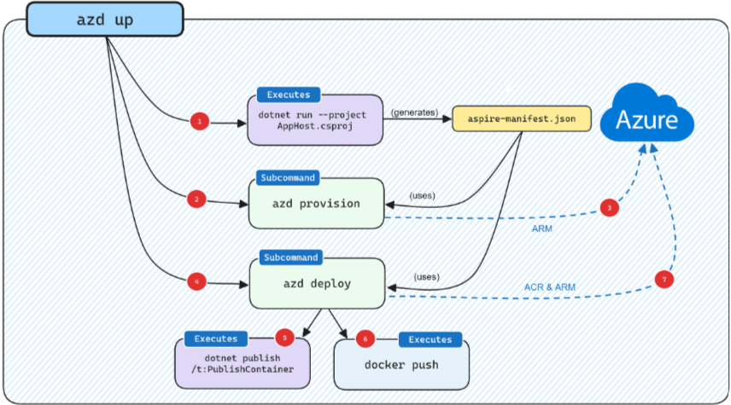

Slide 21
5. Resources
https://learn.microsoft.com/en-us/dotnet/aspire/get-started/aspire-overview
https://learn.microsoft.com/en-us/azure/azure-functions/functions-overview
https://dapr.io
https://learn.microsoft.com/en-us/azure/container-apps/overview

Slide 22
Thanks!
Any questions?
You can find me at: @username · user@mail.me

